Slide 1
CONSULTIME
Web-Based Consultation and Appointment Management System

Slide 2
Problem Statement
Manual scheduling, appointment conflicts, delayed communication, lack of centralized records.

Slide 3
Objectives
Develop a centralized consultation and appointment management platform.

Slide 4
System Architecture
Student → Web App → Database → Faculty → Administrator

Slide 5
Technologies Used
HTML, CSS, JavaScript, Supabase, Authentication, Responsive Design

Slide 6
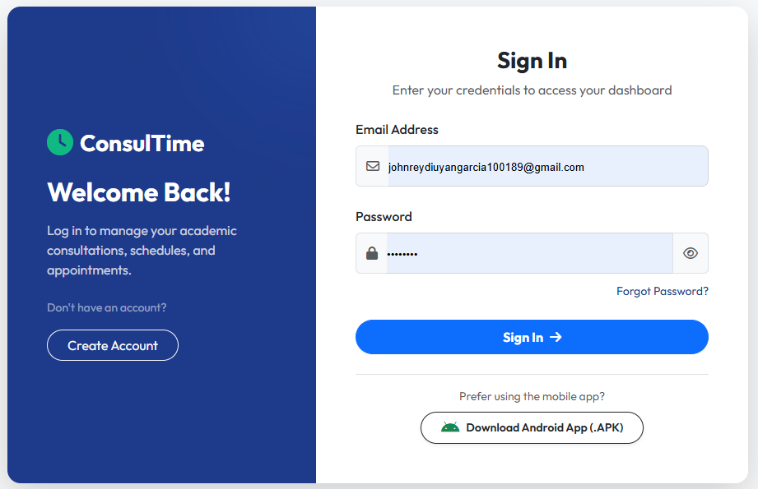
Login Module

Slide 7
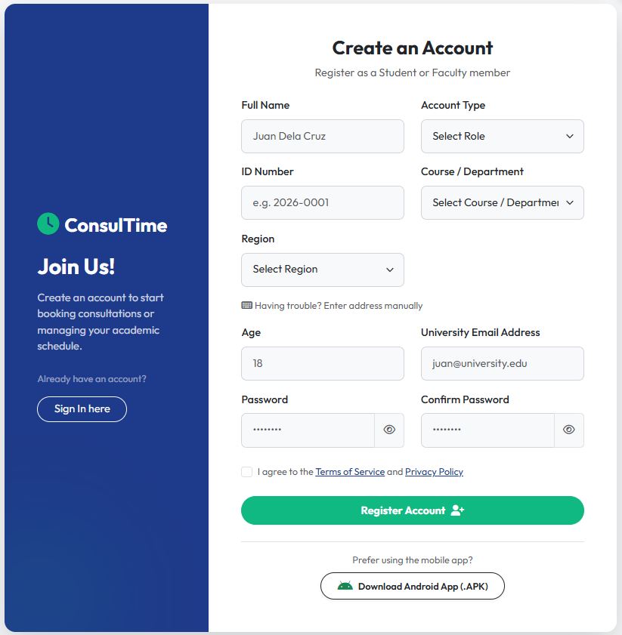
Registration Module

Slide 8
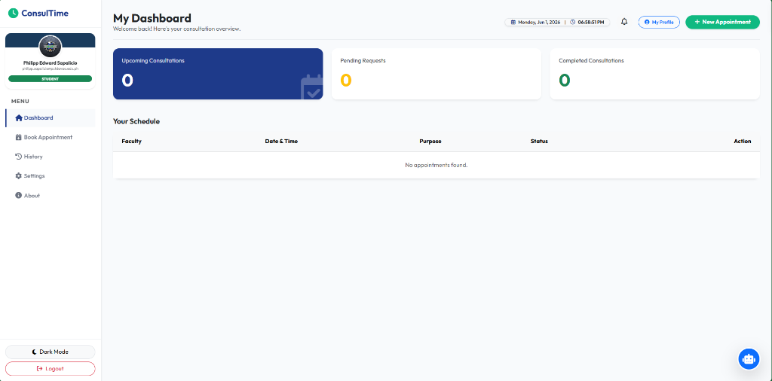
Student Dashboard

Slide 9
Book Appointment

Slide 10
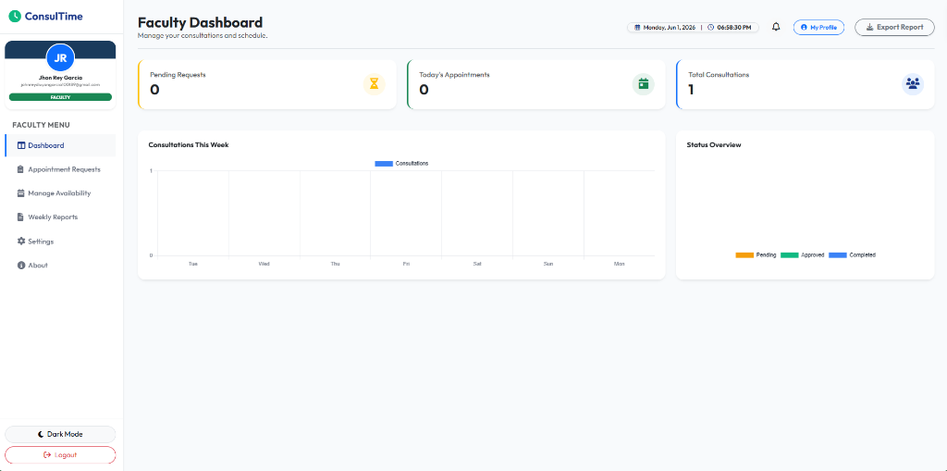
Faculty Dashboard

Slide 11
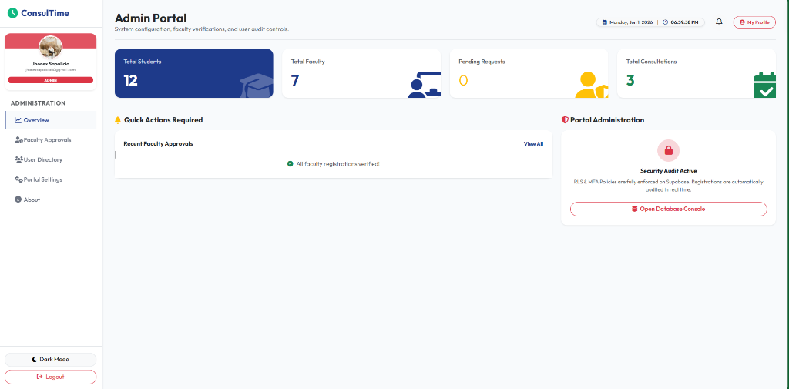
Admin Dashboard

Slide 12
System Evaluation
ISO 25010 Evaluation Results

Slide 13
Device Compatibility
Mobile, Tablet, Laptop, Desktop – 100% Passed

Slide 14
Key Contributions
Centralized scheduling, monitoring, responsive access

Slide 15
Conclusion
ConsulTime streamlined consultation scheduling and communication.

Slide 16
Thank You
Questions and Answers

